Slide 1
CSCI44 Project Presentation
NVDA Price Prediction
A Multi-Model Analysis
Yousef Kahwaji
Mohammad Al Dirani
Ahmad Akoum

Slide 2
CONTENTS
Introduction
Dataset
Feature Engineering
Model Strategy
Supervised Learning
Unsupervised Learning
Conclusion

Slide 3
INTRODUCTION
Stock market prediction is challenging due to noisy, non-linear data and external influences. This project evaluates how well machine learning models predict next-day UP/DOWN movement using technical indicators. NVIDIA (NVDA) stock is used as a case study to assess whether limitations come from the models or the data itself.

Slide 4
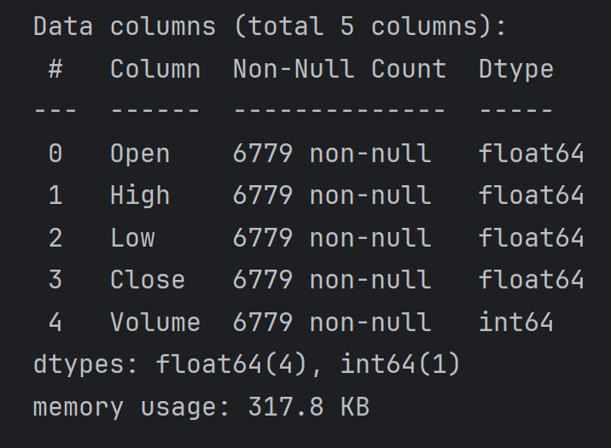
Dataset
The dataset was retrieved from the “yfinance” library and used entirely; it had the following columns:
  Open
  High
  Low
  Close
  Volume
  Dividends
  Stock Splits
The Dividends and Stock Splits columns were removed as they don’t provide any important information

Slide 5
Feature Engineering 1
Knowing that the features that come with the dataset won’t be enough for models to predict a meaningful result, we decided to engineer new features for the dataset.
SMA, Simple Moving Average
  SMA 20
  SMA 50
  SMA 100
  SMA 200
The simple moving average is an average over a set number of days.
From the SMA, we computed the relative distance between the closing price and each SMA: Close / SMA − 1
RSI, Relative Strength Index
  RSI 14
  RSI 30
  RSI 90
RSI helps identify overbought and oversold conditions at different time horizons. It was calculated using the RSI method from the ta library
  ROC, Rate of Change
    ROC 5
    ROC 10
    ROC 20
  ROC captures short-term and medium-term momentum in price changes.

Slide 6
Feature Engineering 2
  Volatility 5
  Volatility 10
  Volatility 15
Volatility was calculated using rolling standard deviations of daily percentage. These features quantify how unstable price movements are over different windows.
To avoid future data leakage, 2 new ranges were introduced
  High Low
  Open Close
These features help represent daily price behavior without referencing future prices.
  Moving Average Convergence Divergence (MACD)
    Line
    Signal Line
    Difference
  MACD provides a non-linear trend-following signal.
Time Based Features
  Day of the week
  Month of the year
These were introduced to help the model follow day or month patterns
NaNs where intentionally left in to test the models’ abilities to handle nulls

Slide 7
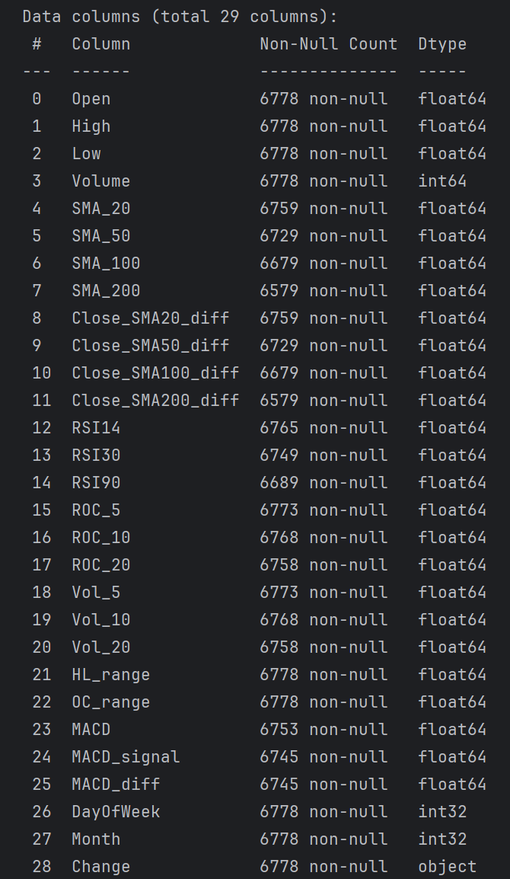
Feature Engineering 3
“Change” output Column
  This column was created because this is a classification problem, where the models are supposed to predict whether the price of the next day is going to go “UP” or “DOWN”
  It was created using the Close column, which was then dropped from the dataset to prevent leakage
  A threshold of 0.5% was introduced so that small changes in the close price doesn’t change the UP or DOWN
  If the next day’s closing price increased by more than 0.5%, then Change is UP, otherwise DOWN
  The last row of the dataset was removed since it has no future value to compare against.

Slide 8
Model Strategy
Multiple classification metrics will be used for evaluation to get the best possible result. (Accuracy, F1, etc.)
Multiple splitting methods will also be used depending on the model. (Kfold, TimeSeriesSplit, etc.)

Slide 9
Supervised Models 1
Models Used
Decision Tree
Random Forest
K-Nearest Neighbors
Support Vector Machine
Default (Gini)
Tuned Entropy
Tuned Gini
Default (Gini)
Tuned Entropy
Tuned Gini
K = 3
K = 8
K = √n
Default RBF Kernel
Balanced with Linear Kernel
Balanced with RBF Kernel

Slide 10
Supervised Models 2
Accuracy Scores
 | DT | RF | KNN | SVM
Model 1 | ~50% | ~55% | ~49% | ~56%
Model 2 | ~49% | ~54% | ~50% | ~55%
Model 3 | ~52% | ~50% | ~55% | ~53%

Slide 11
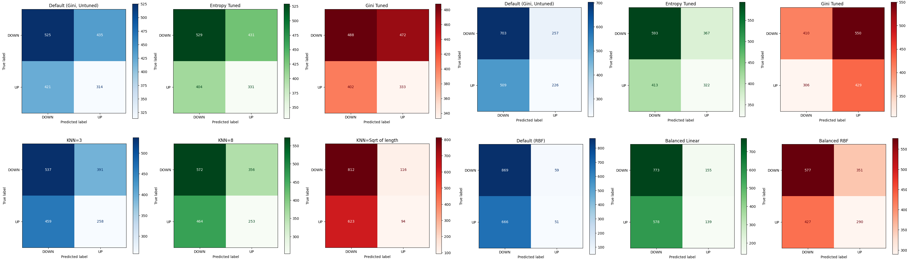
Supervised Models 3
Confusion Matrices

Slide 12


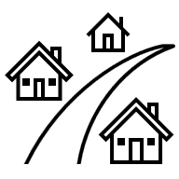

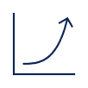
Supervised Models 4
Conclusions
Decision Tree
Random Forest
KNN
SVM
A single Decision Tree is not suitable for this dataset.
Despite being stronger than single trees, Random Forests were still unreliable for this task."
KNN consistently traded balance for accuracy and failed to generalize. It is not suitable for this dataset.
The Balanced RBF SVM was the best-performing supervised model, though still not fully ideal.

Slide 13
WEALTH IS THE ABILITY TO FULLY EXPERIENCE LIFE.
-Henry David Thoreau

Slide 14
AREAS OF FOCUS
Portfolio diversification
Short and long-term goals
Develop winning combinations to stay ahead of the market
Capitalize on direct ownership of digital coins
Invest in multiple blockchains​
Create an emergency fund
Add a second stream of income
Buy a house
Supplement retirement fund

Slide 15
HOW TO GET THERE
Strategize
Minimize risk
Utilize resources
Do your research and develop a plan with goals
Diversify your portfolio through coin ownership​
Follow the markets closely​
Be cautious of scams and "too good to be true" scenarios
Avoid "all-in" strategies
Apps and platforms help streamline user experience
Seek expert guidance from Krypto Logics team members​

Slide 16

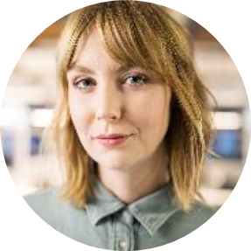


MEET OUR TEAM
Takuma Hayashi​
Mirjam Nilsson​
Flora Berggren​
Rajesh Santoshi​
President
Chief Executive Officer
Chief Operations Officer
VP Marketing

Slide 17




MEET OUR EXTENDED TEAM
Takuma Hayashi​
Mirjam Nilsson​
Flora Berggren​
Rajesh Santoshi​
President
Chief Executive Officer
Chief Operations Officer
VP Marketing
Graham Barnes
Rowan Murphy
Elizabeth Moore
Robin Kline
VP Product
SEO Strategist
Product Designer
Content Developer

Slide 18
ConClusion
At Krypto Logics, we believe in giving 110%. By using our next-generation data architecture, we help investors virtually manage their portfolios. We thrive because of our market knowledge and great team. As our CEO says, "Efficiencies will come from proactively transforming how we do business."

Slide 19
THANK YOU

